Slide 1

Database Management Systems

Slide 2
Team Members
Mehmet Reşit ÇAĞAN 190709045
Ali DİKME
180702012.1
Murat Avzet ASAN 200709602

Slide 3

Data Set Name : Household Data Set

Slide 4
Definition of Data Set
Our data contains different characteristics about various households in the Philippines. To talk about these features in general; information about household members, information about the utilities of their house, and income-expenditure attributes.

Slide 5

Purpose of Data
Investigating specific expenditures of household how relates on features of family using by “Household Data Set”.

Slide 6

Data Presentation
How many files exist: 3 files
How many columns and rows: Totally, 81 columns 124632 rows
How many strings: 15 Strings in dataset
How many integer: 66 Integer in dataset

Slide 7
Data Presentation
The family info file includes the information in the household expense CSV file.
Data to be used : family_info.csv , house_utilities.csv
Columns : 62
Rows : 83088

Slide 8
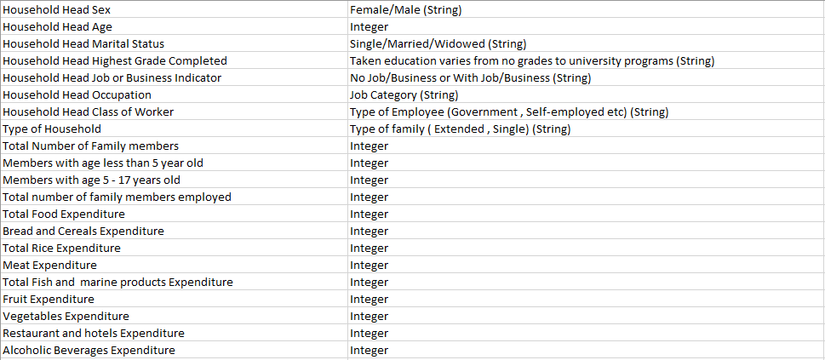
Dataset Attribute Descriptions

Slide 9
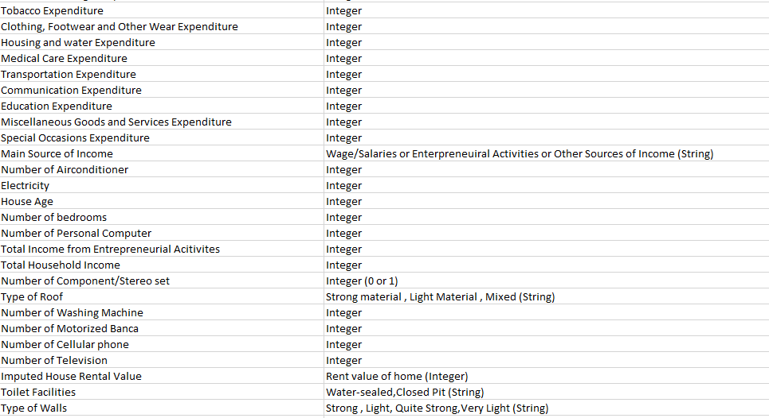
Dataset Attribute Descriptions

Slide 10
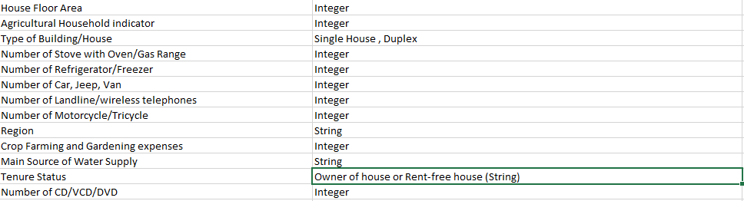
Dataset Attribute Descriptions

Slide 11

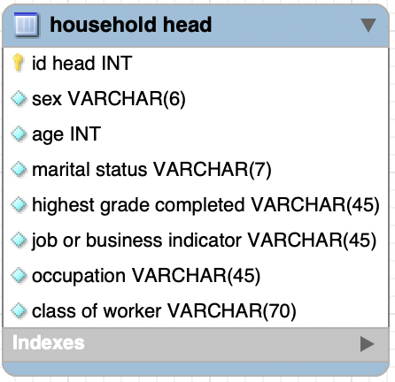

Slide 12
Questions
What is the rate of no job/with job (business indicator)?
What is the mean of households head’s age ?
What is the rate of single family/extended family ?
What is the average number of family members ?
What is the rate of the members who under 5 ages/who between 5-17 ages ?
What is the mean of the family members number who has a job ?
What is the maximum education care expenditure ?
Which houses are priced above the average house price?
Which family has the least education expenses?
What is the mean of bread and cereals expenditure?

Slide 13
Data set Kaggle Link
https://www.kaggle.com/datasets/muhammadsaadkag/household-data-set

Slide 14
End of Presentation , Thank you for listening

